Slide 1
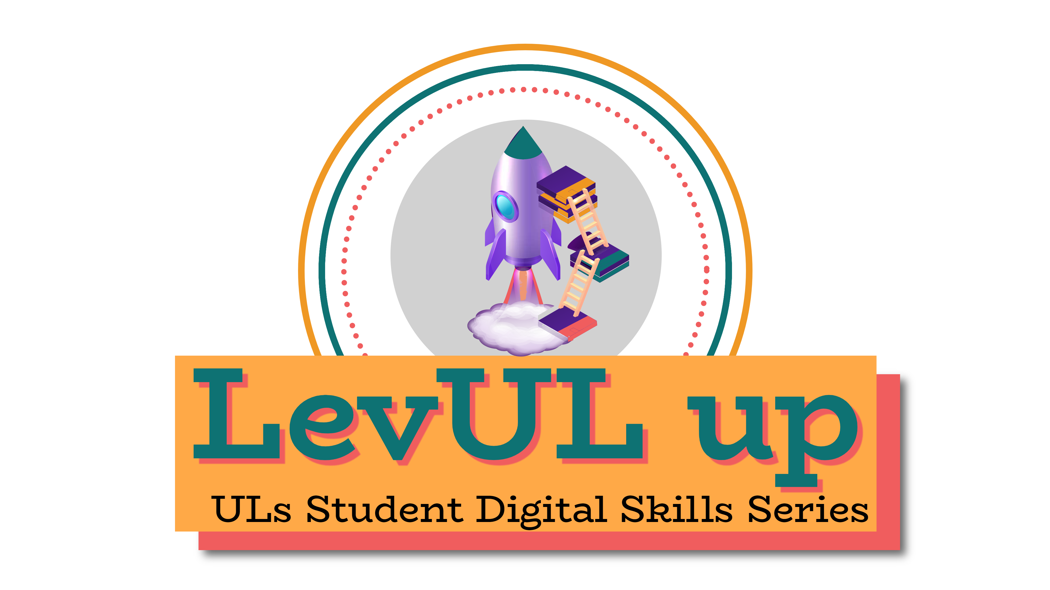
👋 Hello & Welcome
⏳ This session will begin shortly.
While you wait, please download the slides for today’s session from the LevUL up website.
In association with:

Slide 2
Recording
This session will now be recorded. Any further information that you provide during a session is optional and in doing so you give us consent to process this information.
These recordings will be stored by the University of Limerick for one year and may be published on our website during that time.
By taking part in a session you give us your consent to process any information you provide during it.

Slide 3
Digital Literacy & Wellbeing
Dr Michael Wride,
Transformative Pedagogies Lead

Slide 4
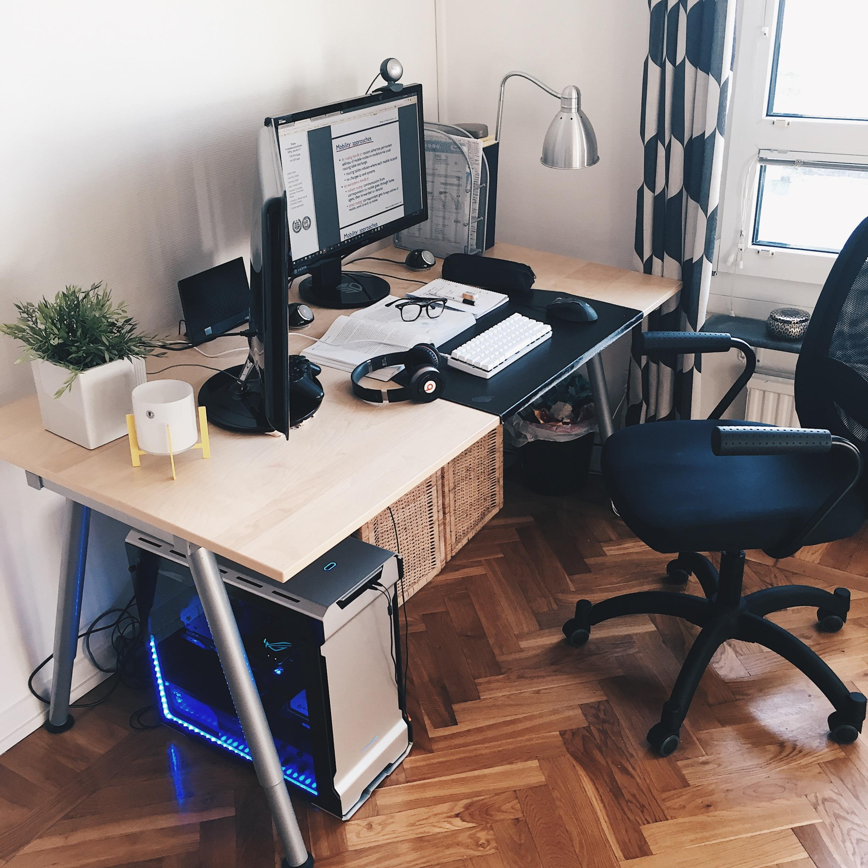
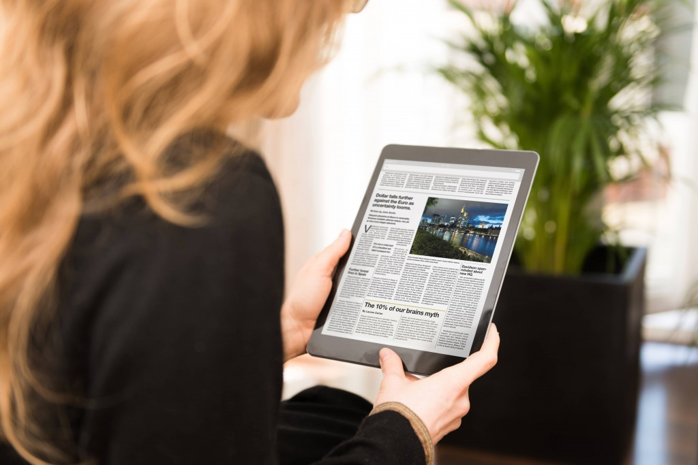
Overview: ‘digital literacies’ & 'digital wellbeing’
In this workshop, we will explore digital literacies, why they are important, and how to ensure your health & well-being within a digital world.
‘digital literacies’ looks beyond ‘IT skills’ and encompasses:
our digital behaviours (how we behave online),
our practices (how we use technologies and engage with others online)
our identities (our digital footprint).
Reading online
'digital wellbeing’ refers to the impact of technologies and digital services on our mental, emotional and physical health.
Setting up your workspace

Slide 5
Overview
We live in an increasingly digital society:
rapid developments in technology have changed how we communicate, collaborate, access, consume & produce information, and how we learn.
Some people even argue that technologies are changing the way we behave and think!
It’s important that we have the skills, knowledge and capabilities needed to use these technologies effectively and safely.

Slide 6
Objectives
At the end of this workshop you will be able to…
appreciate how technology has changed how we communicate, collaborate, access, consume & produce information, and how we think & learn.
develop the skills, knowledge and capabilities needed to use these technologies effectively and safely.
read effectively online.
set up your study space

Slide 7
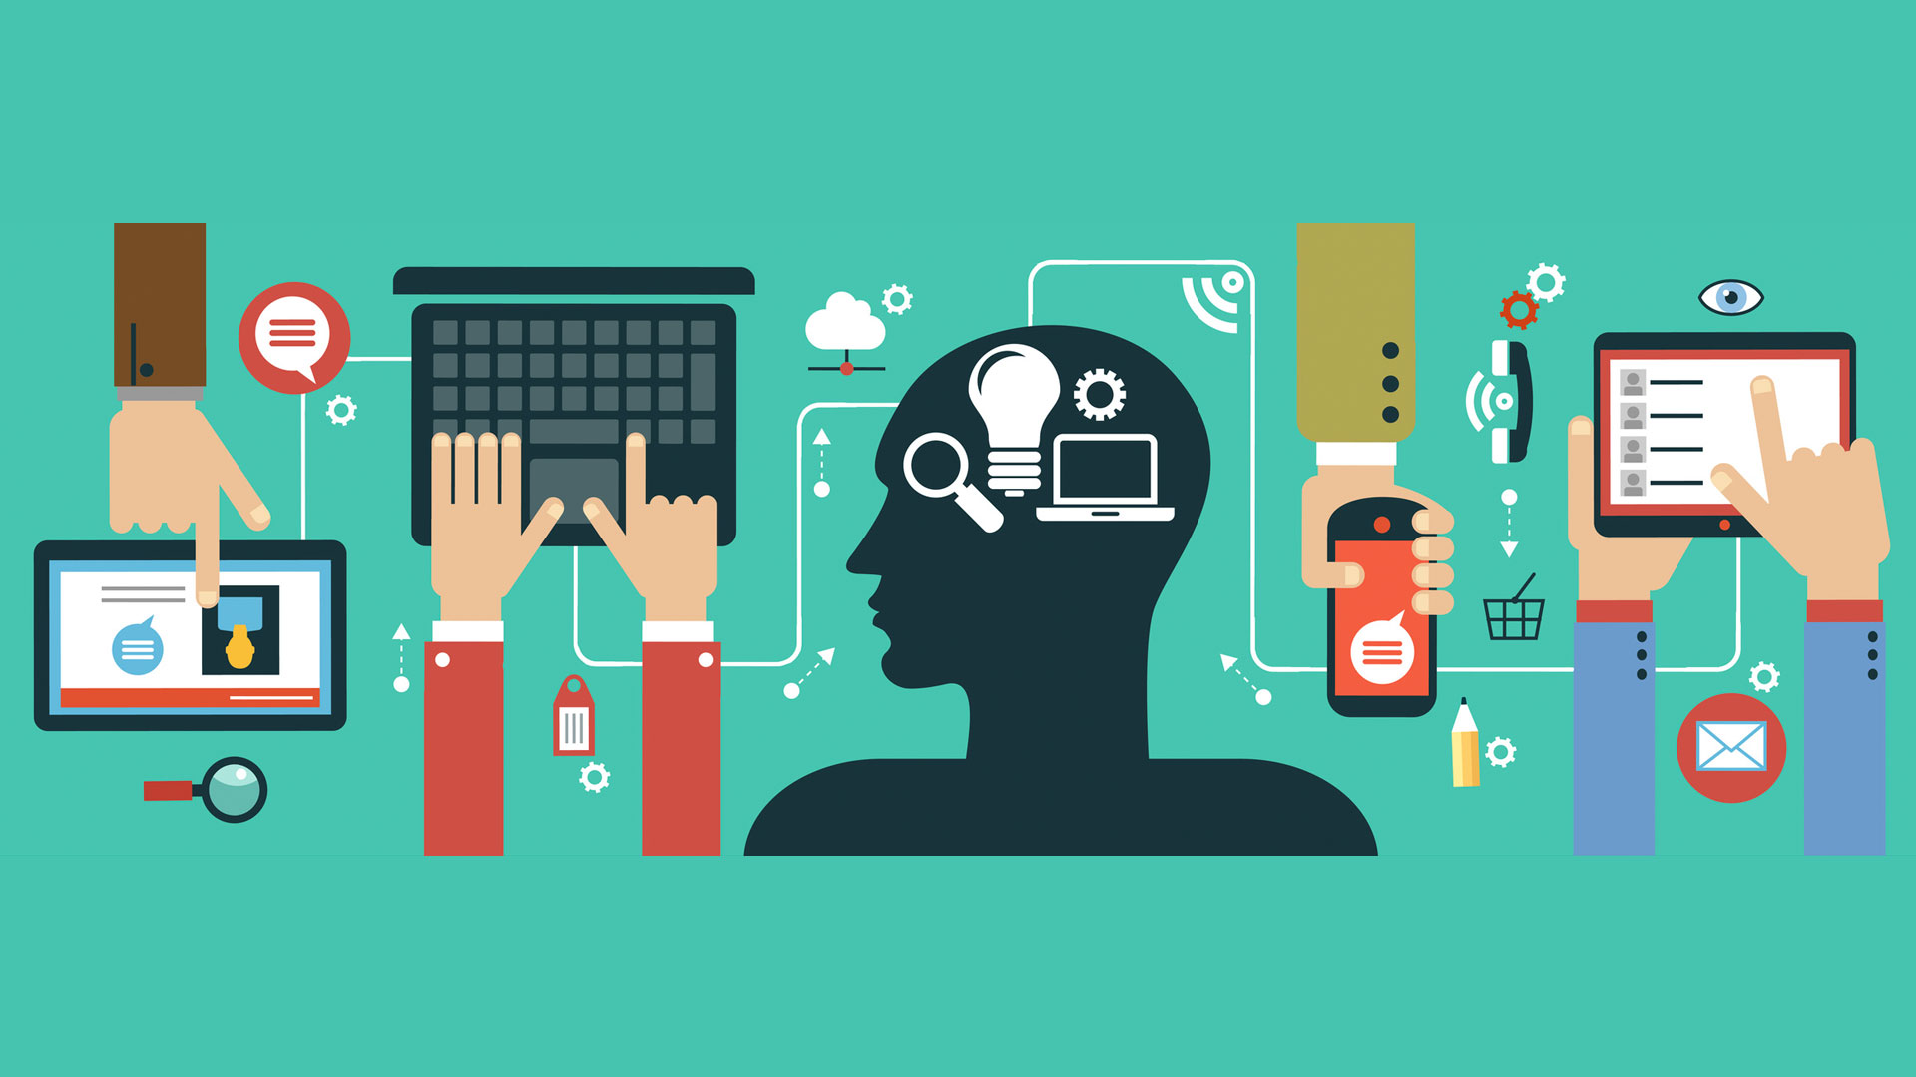
Digital Literacies (EU Digital Competence Framework)
Information and data literacy:
locate, retrieve, store and manage digital data, content and information.
assess the relevance of the source and the validity of its content
Communication and collaboration:
interact, communicate and collaborate with others through the use of digital technologies
manage digital identity and online reputation
create, edit and improve digital content (licensing and copyright).
revise and integrate information
.

Slide 8
Digital Literacies (EU Digital Competence Framework…Cont)
Safety
ensure that personal and work devices are protected, including personal and work-related data and sensitive information in digital environments.
understand how technology impacts mental and physical wellbeing and a general awareness of the environmental impact of digital.
Problem solving
identify needs and problems and resolve them in different digital environments.
use digital tools to improve processes, services and products, and keep up to date with the evolution of technology

Slide 9
Understanding what you read online
Online reading comprehension involves different skills and practices than reading a physical text.
You might read books well, but you might need to adapt your approaches to read well on the Internet.
Imagine that you’ve been asked to read about a topic on the web:
formulate relevant questions to provide a purpose for your inquiry,
set a context for problem solving and
establish relevant goals for your learning.
How will you evaluate the relevance of information to the task?
How will you distinguish between the quantity of information and the quality of that information?

Slide 10
Steps for an online reading project
There are a series of steps and questions you can use for an online reading project:
Locating:
What do I need to know more about?
Which search words should I use?
Evaluating:
Which search results are the most useful?
How do I know it’s true?

Slide 11
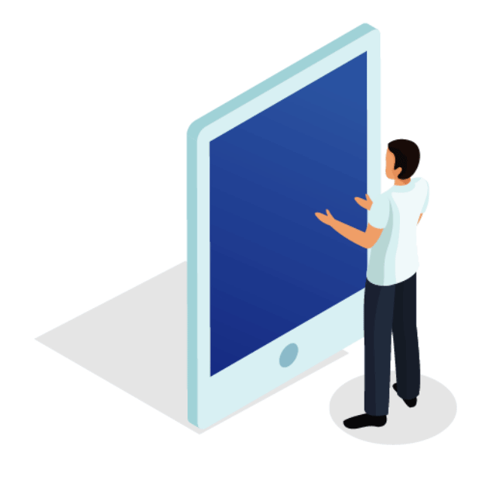
Reading online
Reading on e-readers, tablets, smart phones, and computers are different things. Try to become fluent in navigating your digital devices and their corresponding online environments.
People reading online—or on digital devices—are often more easily distracted, read less carefully and deeply, are less able to read longer texts, and understand less of what they read.
Reading on almost any digital device requires much greater focus than reading in print does.
Self-motivation and persistence in an online environment is crucial to avoid cognitive overload, distraction and disorientation.
Notes:
reading on e-readers, tablets, smart phones, and computers are different things. Try to become fluent in navigating your digital devices and their corresponding online environments.
People reading online—or on digital devices—are often more easily distracted, read less carefully and deeply, are less able to read longer texts, and understand less of what they read.
Reading on almost any digital device requires much greater focus than reading in print does. Self-motivation and persistence in an online environment is crucial to avoid cognitive overload, distraction and disorientation.

Slide 12
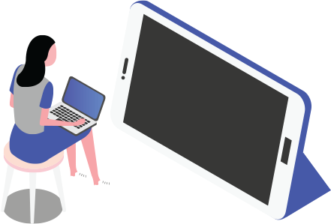
Reading online Cont…
Read selectively and strategically, monitoring the text
Know what level you want to read it at and for what purposes—skim-reading /reading more deeply to analyze and/or critique various sides of an argument.
Practice evaluating and monitoring by navigating effectively through websites and embedded hyperlinks.
The content of hyperlinks is hidden from view so you may be less able to construct meaning by drawing on contextual information.
Hyperlinks are “constant decision points” for understanding in multimedia texts.
It’ll also help to make notes and write summaries about what you read, as the acts of reading and writing are intertwined.
Notes:
read selectively and strategically, monitoring the text to be read. Know what level you want to read it at and for what purposes—you might be skim-reading to get the gist of an argument, evaluate an author’s credibility or you might be reading more deeply to analyze and/or critique various sides of an argument.
Practice evaluating and monitoring by navigating effectively through websites and embedded hyperlinks. The content of hyperlinks is hidden from view so you may be less able to construct meaning by drawing on contextual information. Hyperlinks are “constant decision points” for understanding in multimedia texts. It’ll also help to make notes and write summaries about what you read, as the acts of reading and writing are intertwined.

Slide 13
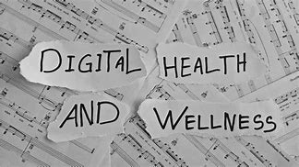
Digital Health & Wellbeing
Understanding the positive benefits and any potential negative aspects of engaging with digital activities is key to ensuring learner wellbeing.
The impact of technologies and digital services on people’s mental, physical, social and emotional health can be wide-ranging.
What we share and how we conduct ourselves online affects our wellbeing.
How much ‘stuff’ have we shared online and how easily can it be found?
Knowing what the boundaries are is key. Knowing how to navigate appropriately and safely online to create model online learning communities.
Notes:
Understanding the positive benefits and any potential negative aspects of engaging with digital activities is key to ensuring learner wellbeing.
The impact of technologies and digital services on people’s mental, physical, social and emotional health can be wide-ranging.
What we share and how we conduct ourselves online affects our wellbeing.
How much ‘stuff’ have we shared online and how easily can it be found?
Knowing what the boundaries are is key. Knowing how to navigate appropriately and safely online to create model online learning communities.
We also want to develop skills in critical thinking, reflection and argument, but we need to be critical constructively and to engage in public discourse appropriately.
Online aggressive bullying is real and can be instantaneous and very harmful – we all have rights and responsibilities within our digital learning communities (just like face to face learning).
Beware the simplistic rhetoric of social media
How are we seen? knowing how web sites use data and algorithms online, managing browsing histories, take back some control – be mindful of the Terms & Conditions re: data sharing and consider using other browsers and/or search engines.

Slide 14
Digital Health & Wellbeing
We also want to develop skills in critical thinking, reflection and argument, but we need to be critical constructively and to engage in public discourse appropriately.
Online aggressive bullying is real and can be instantaneous and very harmful – we all have rights and responsibilities within our digital learning communities (just like face to face learning).
Beware the simplistic rhetoric of social media
How are we seen? knowing how web sites use data and algorithms online, managing browsing histories, take back some control – be mindful of the Terms & Conditions re: data sharing and consider using other browsers and/or search engines.
https://youtu.be/vgfBSkPw5zQ
Sheila MacNeill, Heriot-Watt Learning and Teaching Academy

Slide 15
Your Study Space
Reflection
Is it a nice place to work?
What are the good things about it?
What are the challenging things about it?
What could you do to make it even better?

Slide 16
Setting Up Your Study Space
Physical environment: managing your workspace, e.g. noise, light, clutter etc
Virtual environment: managing distractions, e.g.email, news, social media
Social environment: managing interactions with family, housemates, friends, lecturers etc
**Keep your work and relaxation spaces separate** - don’t study in bed!
Reflection:
Do you find background noise/music helpful or distracting?
Do you need to move around while you learn; e.g. do you take regular screen breaks?
Are you easily distracted by things you see?
What items do you need to study effectively? (e.g. laptop, notepad, pens, highlighters etc)
Reflect on what works for you!

Slide 17
The Physical Environment
Table/Desk & Chair?
Separate workspace in your room
Tidiness of your workspace: declutter every day
Ergonomics:
Is your work environment comfortable?
Avoid strain on neck, back, joints and eyes
Use a headset and microphone

Slide 18
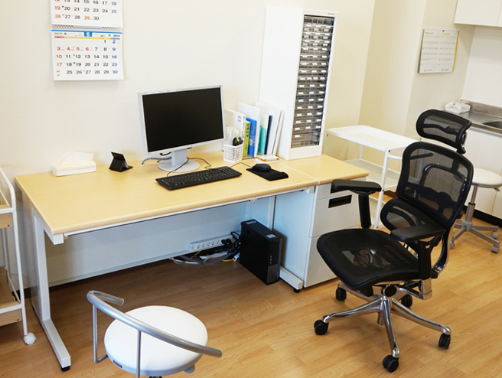
The Visual Environment
Sufficient light
Only have essential items on your desk
Position yourself away from a window/or areas in the house where people are moving around
Place your desk next to a blank wall

Slide 19
The Auditory Environment
Use headphones/earphones/earplugs
Listen to instrumental music/nature sounds etc
Spotify: Music for concentration playlist
YouTube: RelaxDaily channel
Apps: Relaxio or A Soft murmur

Slide 20
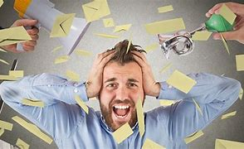
The Virtual Environment
Only check emails and news outlets at certain times of the day
Use a media/App blocker on your phone and laptop: ColdTurkey or Freedom
Use BreakTimer on your lap top to ensure you take a 5 min break every hour.
Be familiar with the Sulis, BigBlueButton and Teams as this is how your learning will happen online at UL.

Slide 21
Recap & Summary
how technology has changed how we communicate, collaborate, access, consume & produce information, and how we think & learn.
the skills, knowledge and capabilities needed to use these technologies effectively and safely.
read effectively online.
set up your study space

Slide 22
Where from here?
This Photo by Unknown Author is licensed under CC BY-SA

Slide 23
Support & Resources
https://www.ul.ie/ctl/workshop-digital-literacies-and-wellbeing-getting-started
https://ec.europa.eu/jrc/en/digcomp/digital-competence-framework

Slide 24
Thank you

Slide 26
This work is licensed under a Creative Commons Attribution-NonCommercial 4.0 International (CC BY-NC 4.0)

